Slide 1


Coffee-Shop Sales Analysis
LINDOKUHLE NKAMBULE

Slide 2
Data Analysis
THE COFFEE SHOPS HAS 3 REGIONS
01
IT HAS BEEN RUINING FOR 6 MONTHS
02
SALES STARTED FROM JANUARY 2023- JUNE 2023.
03

Slide 3
Problem statement
Coffee shop is running smooth shop, but we want to have insight which product have most sales, in which regions and what time bucket are the busiest.
Raw data set from everyday sales can not show analysis but it can be foundation of producing insightful analysis.
We want to visualize months that boost sales.
We want to visualize which product generates more revenues.

Slide 4
Technology used
ETL(Extract, Transform, Load)- We prepare raw data set for analysis, clean, format, and enrich the data to make it usable.
SQL-For querying databases, It helps you retrieve, manipulate, and analyze data stored in tables.
Snowflakes- is a cloud data warehouse that we upload our raw data set into, I write queries to retrieve explore and manipulate data easily.
Manages pipeline for our dataflow.
Excel Pivots tables and graphs are the best tool for analysis.
Power BI for visualization and reports.

Slide 5
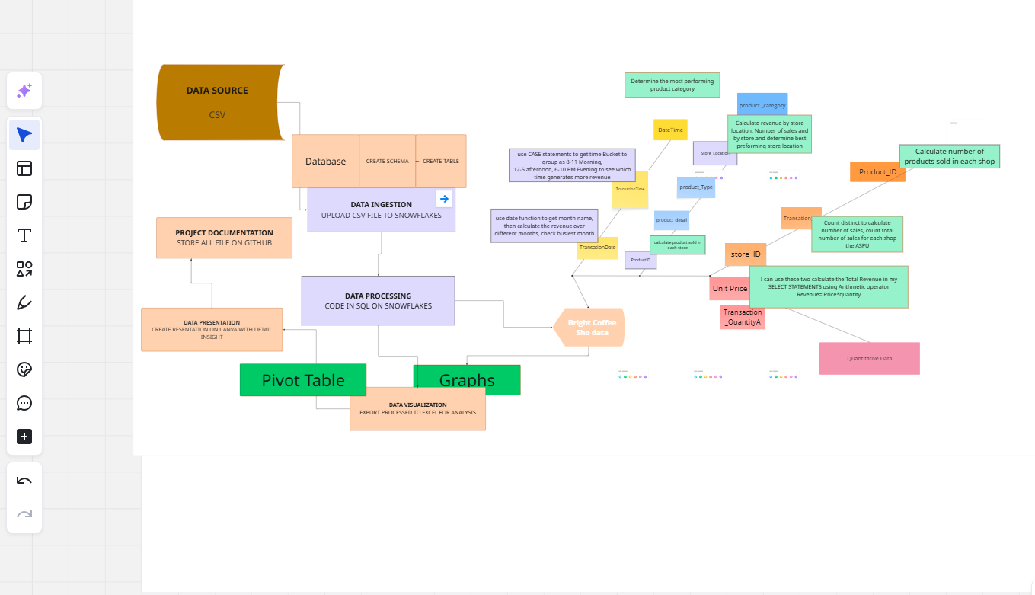
Project planning with Mira

Slide 6
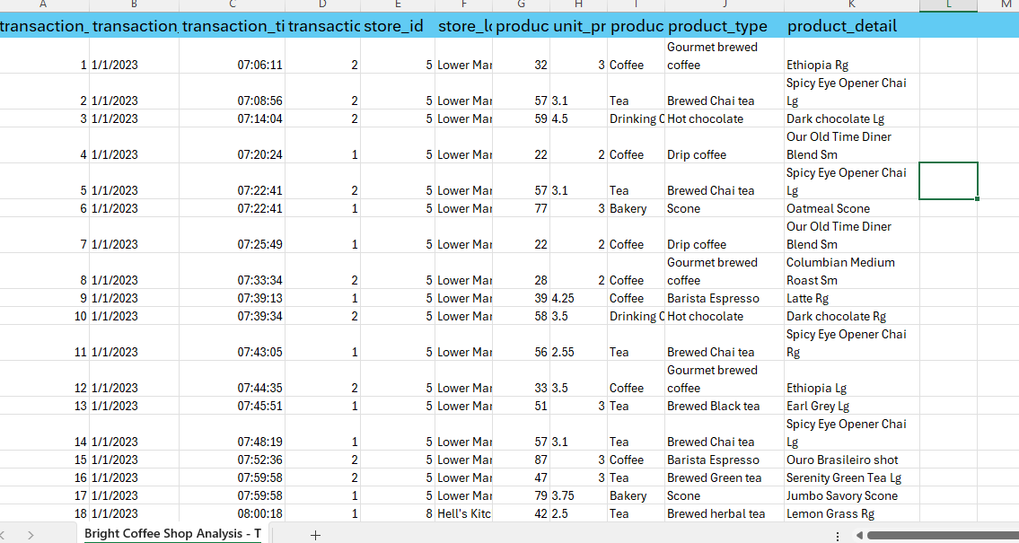
Raw data set before ETL on Snowflakes, 11 columns

Slide 7
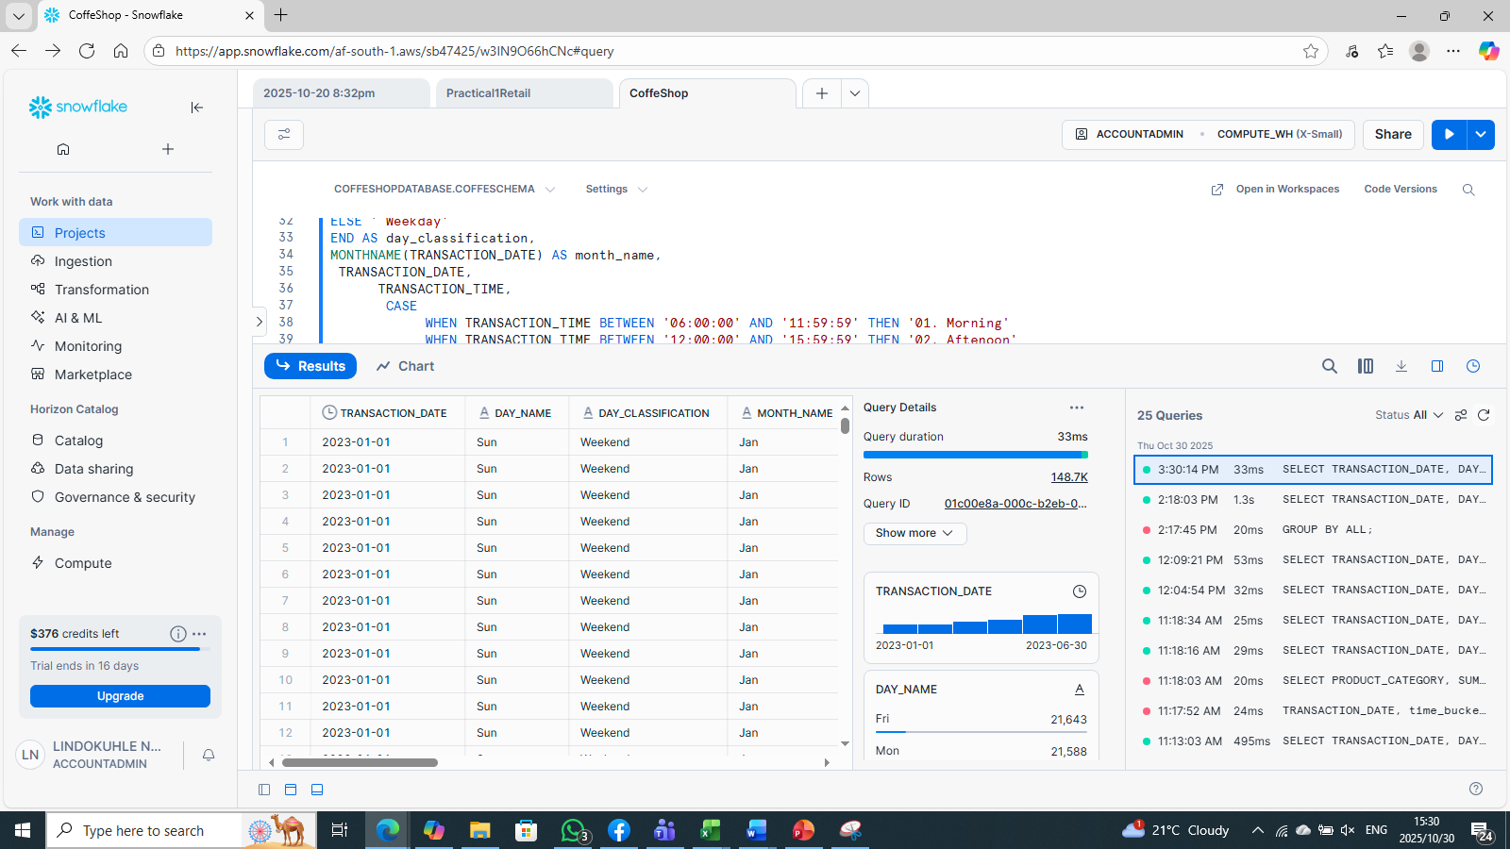
ETL-SQL query to extract data from database schema and table

Slide 8
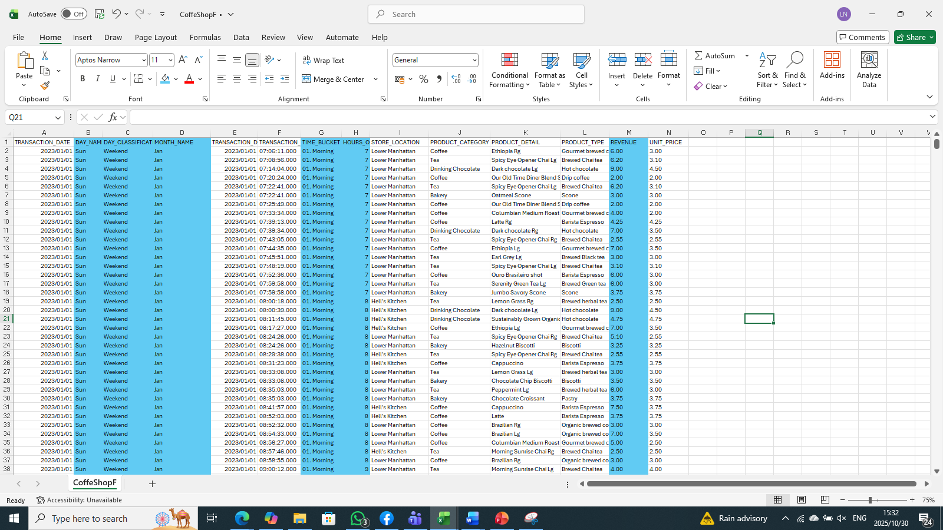
Extracted, cleaned and modelled data set after SQL, loaded to excel csv, 16 Columns

Slide 9
Pivot tables and Graphs
Revenue across all the store increased by 5o% from February to June

Slide 10
Populating month with the highest total Revenue
From March revenue accumulated from month to month; This means the business is doing well as they grow
Total Revenue=R698812.33
from Jan-Jun

Slide 11
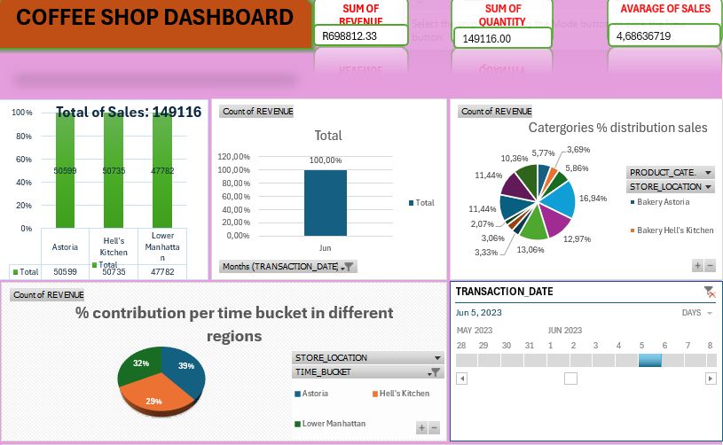
DASHBOARD 1

Slide 12
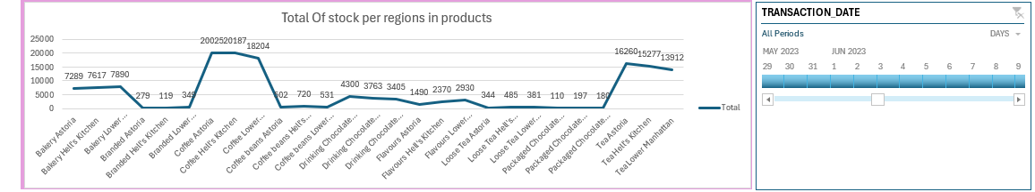
DASHBOARD 2
Timeline is tool for filtering months, date and days
DSDSC

Slide 13
Insights
Location Revenue Distribution 3 store locations contributed nearly equally to total revenue.
Time-of-Day Sales Pattern Sales volume by time of day (highest to lowest): Morning Afternoon Evening Night Product Contribution Coffee & Tea products account for 67% of total revenue. Other items (e.g., pastries, snacks) make up the remaining 33%

Slide 14
THANK YOU!!!
Lindokuhle Nkambule
073903134
lindoh1313@gmail.com

